Slide 1
School Improvement Plan (SIP) Sept ‘18
Leadership and Management at all levels
Assessment
More Able
Behaviour for Learning

Slide 2
The Team
Chair – Chris Snaith
Vice Chair – Victoria Critchley
Acting Head Teacher - Louise Henry
SGC Clerk – Gill Eardley
Subcommittee Chairs
Resources - Bart Simpson
Standards & Curriculum - Anthony Ballard
School Improvement Plan - Victoria Critchley

Slide 3
Governing Code of Conduct NGA 2018
Strategic Functions
Direction - vision, values, objectives, agreeing SIP, meeting statutory duties;
Ensuring Accountability – monitoring educational performance and progress towards agreed targets, engaging with stakeholders, contributing to the school self evaluation;
Overseeing financial performance – overseeing the budget, monitoring spending, ensuring value for money, ensuring risks to the school are managed.

Slide 4
Code of Conduct cont.
Roles & Responsibilities
Please refer to our Code of Conduct – to be distributed for Nov SGC R/V.
Examples include acting fairly, encouraging open governance, working collectively, adhering to school rules and policies
MOD schools differ from UK State schools re. not being directly responsible for staff recruitment or for the complete budget, although is accountable for the money it spends and the resources it provides.

Slide 5
Code of Conduct cont.
Commitment
We will:
Involve ourselves actively,
Attend all meetings, when we cannot attend explain in advance to the Clerk why we are unable to,
Become familiar with the school, respond to opportunities to involve ourselves in school activities,
Visit the school with all visits arranged in advance with the HT and undertaken within the framework established by the SGC.
Undertake required training
Accept that in the interests of open governance, our names will be on the school website and on the DfE’s national database of governors.

Slide 6
Code of Conduct cont.
Relationships
We will:
work as a team,
Express views openly, courteously and respectfully,
Support the chair in their role of ensuring appropriate conduct,
Be prepared to answer queries from other board members in relation to delegated functions,
Seek to develop effective working relationships with the SLT, staff and parents.

Slide 7
Code of Conduct cont.
Confidentiality
We will:
Observe complete confidentiality,
Exercise the greatest prudence at all times when discussions re. school business arise outside of a SGC meeting,
Not reveal the details of any governing board vote,
Ensure all confidential papers are held and disposed of appropriately.
Understand that the requirements relating to confidentiality will continue to apply after we leave office.

Slide 8
Code of Conduct cont.
Conflicts of Interest
We will:
Record any business interest that we have in connection to the governing board’s business in the Register of Business Interests.
Accept that the Register of Business Interests will be published on the school website.
Declare any conflict of loyalty at the start of the meeting should the situation arise.
Act in the best interests of the school as a whole and not as a representative of any group.

Slide 9
Code of Conduct cont.
Breach of this Code of Conduct
Raise the issue with the chair and the chair will investigate.
The governing board will only use suspension/removal as a last resort.
Should it be the chair that we believe has breached the code, the vice chair will investigate.

Slide 10
Code of Conduct (the last one)
‘The 7 Principles of Public Life’ (Nolan Committee)
Selflessness
Integrity
Objectivity
Accountability
Openness
Honesty
Leadership

Slide 11
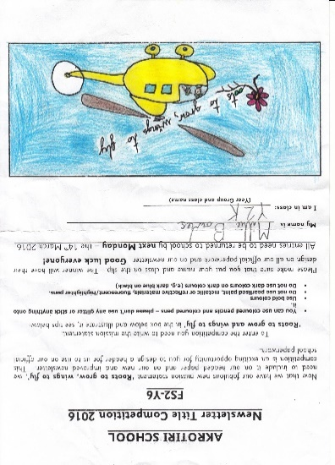
Key Roles Summary
To provide a Strategic View (SIP, Curriculum)
To act as a Critical Friend (monitoring and evaluating effectiveness)
To ensure Accountability (resources, standards, school performance)

Slide 12

Akrotiri School
SGC Governor Curriculum Team Report
Form 1
Name: |  |  | Date:
Focus of Visit:
1 | Key points in relation to SIP:
2 | Progress and impact to date:
3 | Next steps:
4 | Governor support:
3 Main Points
Governor Signature: |  | Date submitted:

Slide 13
Governor of the Month
You’ll receive the dates of assemblies and special events from SGC Clerk.
Please notify the SGC Clerk what you plan to attend.
Wear your SGC name badge, sign in and don your red Visitors lanyard.
The School office staff will help direct you.
Write a brief summary and submit to the SGC Clerk for publication in the online school newsletter.
If your plans change, please arrange a substitute by contacting the governors not currently allocated to a month.

